Slide 1

Team 2: Unit Fit
Project Presentation

Slide 2
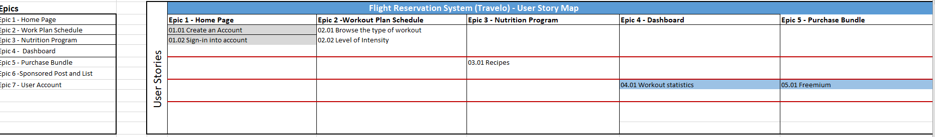
1. Road Map

Slide 3
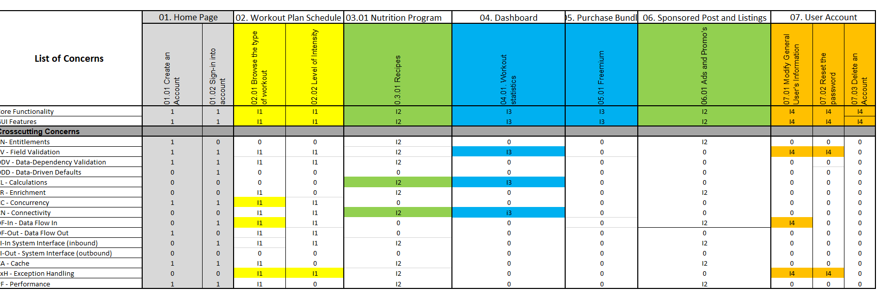
2. RCT Details Tab

Slide 4
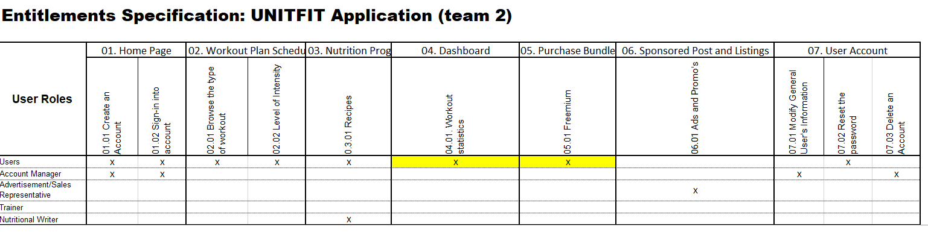
3. Entitlements Specification

Slide 5
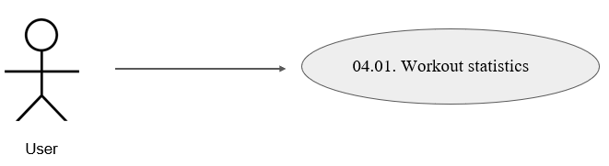
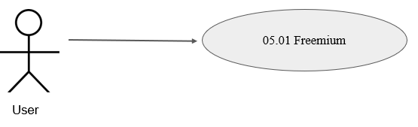
4. Use case Diagram - Iteration 3

Slide 6
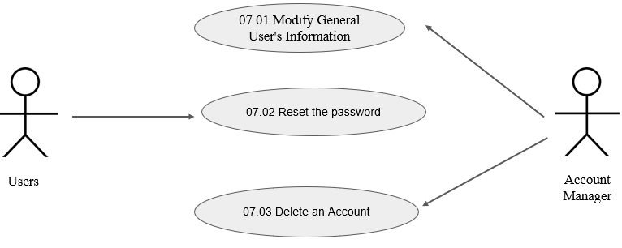
5. Use case diagram - Iteration 4

Slide 7
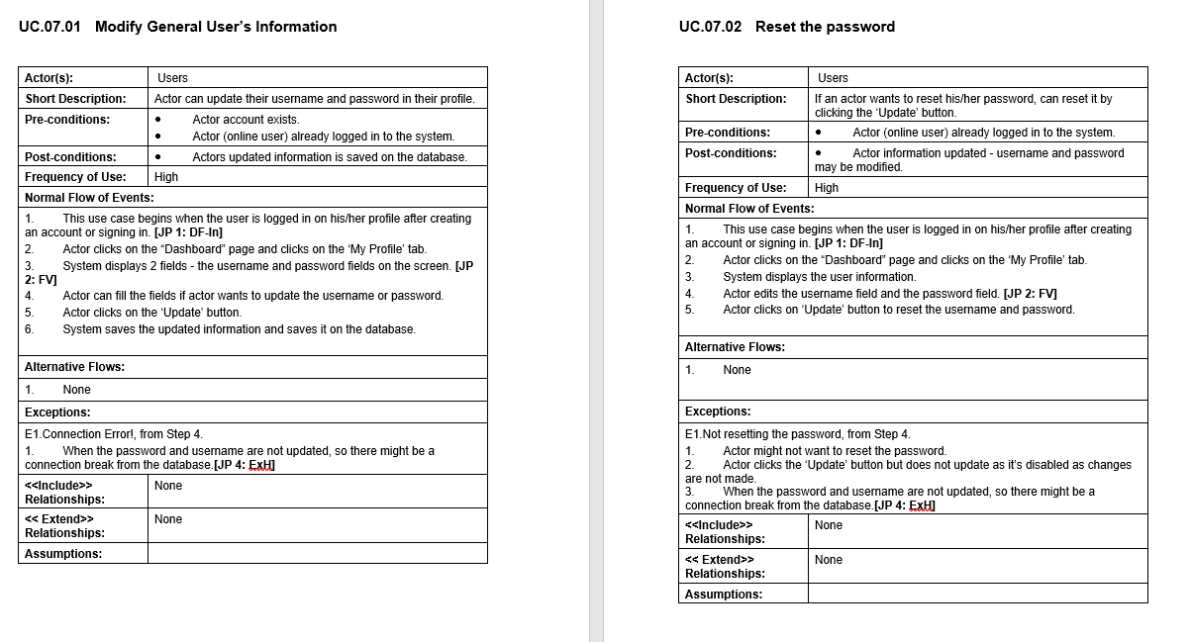
6. Use case specification

Slide 8
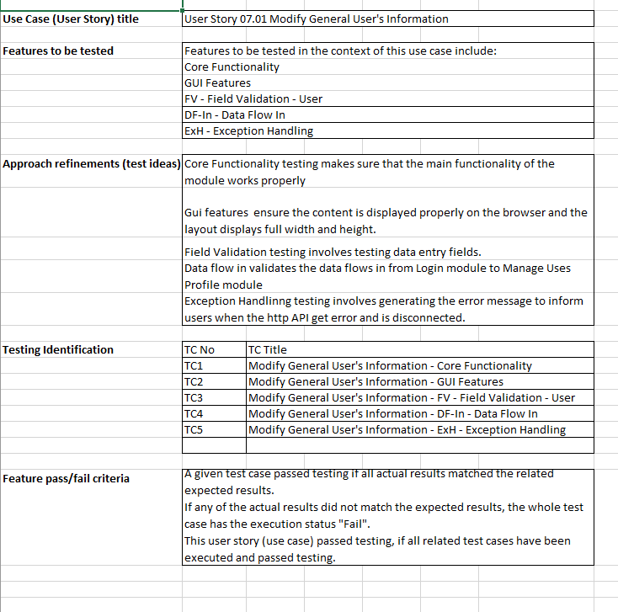
7. Functional Test - User Story 07.01 Modify General User's Information

Slide 9
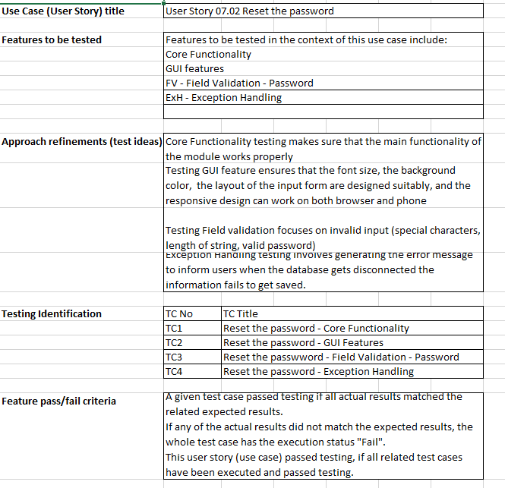
7. Functional Test - User Story 07.02 Reset the password

Slide 10
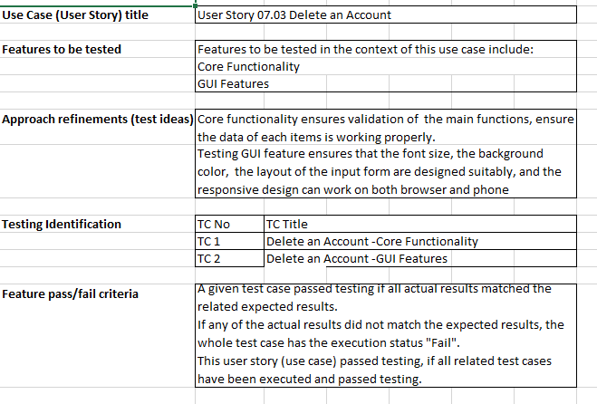
7. Functional Test - User Story 07.03 Delete an Account

Slide 11
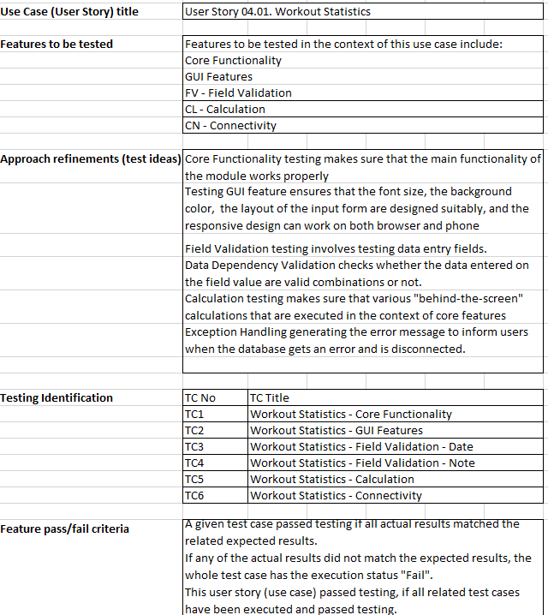
7. Functional Test - User Story 04.01. Workout Statistics

Slide 12
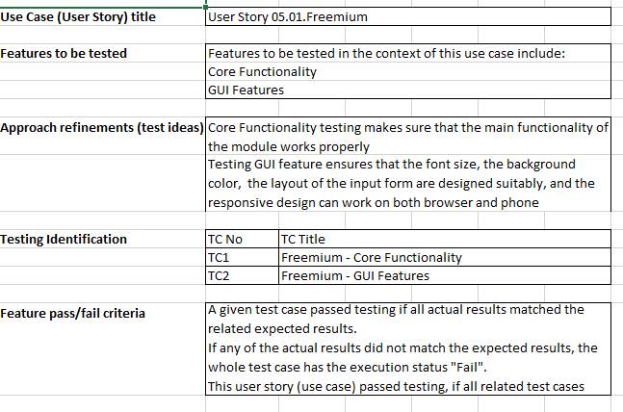
7. Functional Test - User Story 05.01.Freemium

Slide 13
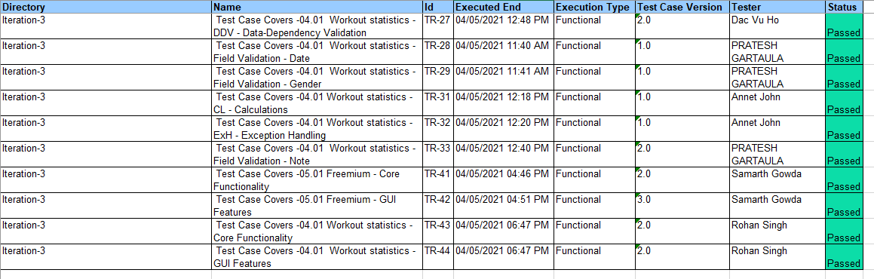
8. Test execution log : Iteration 3

Slide 14
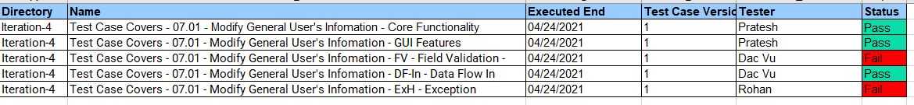
8. Test execution log : Iteration 4

